Slide 1
Lecture LA05
UI Control
ITP271 :: Web Application Development & Project

Slide 2
Overview
Label
Text Box
DropDownList
AdRotator
Table
Image
Menu
SiteMapPath
RadioButtonList

Slide 3
Web Server UI control
ASP.NET constructs web page that is made up of web server UI control
UI control describes the look and feel and behavior of your page event
UI control uses asp: markup tag
  <asp:Label ID="Label3" runat="server" Text="User Id"></asp:Label>
Type of control
Attribute or Property
Web Server control

Slide 4
Web Server UI control
Every UI control will have a set of attributes
ID attribute is used to name the control. It is a good practice to give a meaningful name to the control to ease the programming.
You can directly assign the value to the attribute via Visual Studio Property pane.
Many time we may need to programmatically assign or get the value of the property

Slide 5
Label
Display text in the browser
You can place the content to be displayed in the text attribute of the control
<asp:Label ID="Lblmsg" runat="server" Text=“Name required "> </asp:Label>
You can also provide content via programmatic means in your code behind page
Lblmsg.Text = “Name required”

Slide 6
Textbox server control
Provides a text box for user to input text
  <asp:TextBox ID="txtPassword" runat="server" TextMode="Password"> </asp:TextBox>
Important attribute for textbox :
  TextMode – “Password” will encode input as ****
  “Multiline” create multi line text
  Text –
    get the value from text box
    If (txtPassword.Text = = " " )
    Assign value to text box from database or object
      txtName.Text = customer.name

Slide 7
Dropdown list server control
Display list of item for user to select
Dropdown list can be a collection of items specified in property
  <asp:DropDownList ID="ddlCountry" runat="server"
  <asp:ListItem>Singapore</asp:ListItem>
  <asp:ListItem>Malaysia</asp:ListItem>
  <asp:ListItem>Indonesia</asp:ListItem>
  </asp:DropDownList>
Usually we program the code to get the selected item
String Item = ddlCountry.SelectedItem.Text or
String ItemValue = ddlCountry.SelectedItem.Value or
int ItemIdx = ddlCountry.SelectedIndex

Slide 8
AdRotator
Display different advertisement image each time the page is loaded
The advertisement page is described in a xml file

Slide 9
Ad XML file
<?xml version="1.0" encoding="utf-8" ?>
<Advertisements>
<Ad>
<ImageUrl>images/calculatorfinal.jpg</ImageUrl>
<NavigateUrl>http://www.realtimeindicators.com/calculators.html
</NavigateUrl>
<AlternateText>Calculators</AlternateText>
<Impressions>50</Impressions>
<Keyword>General Calculator</Keyword>
</Ad>
<Advertisements>

Slide 10
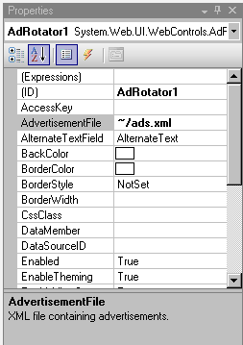
AdRotator

Slide 11
Table
Allow more properties setting compare to the HTML table
Can make use of Theme
Table control is used in conjunction with table row and table cell control

Slide 12
Table
TableRow
TableCell | TableCell | TableCell
TableCell | TableCell | TableCell
  row = new TableRow();
TableRate.Rows.Add(row); // add the row into the table
cell = new TableCell();
cell.Text = "Employee Age(years)";
row.Cells.Add(cell); // add the cell into the row

Slide 13
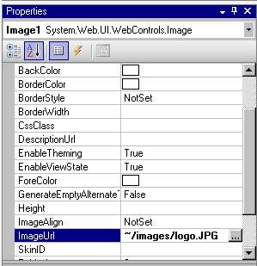
Image
Just drag and drop a image control and set the ImageUrl property to image source
Dynamically we could also assign the image to the ImageUrl. Eg in shopping cart the products images can be retrieved from server

Slide 14

RadioButtonList
A Group of exclusive radio button
Only one button can be selected
Usually we check the value of radio button that is clicked.
  if (RadioButtonListWageCap.SelectedValue == "Yes")

Slide 15
Summary
Control
Initialize Control Dynamically

